Slide 1


Holistic Extensibility for Integrated Data Analysis Pipelines in DAPHNE
Patrick Damme
Technische Universität Berlin
Invited Talk at CDMS@VLDB 2023, Vancouver, Canada, Aug 28, 2023

Slide 2

Modern Data-driven Applications
Biomedical Engineering
ML-assisted Manufacturing
Natural Sciences
Transportation
Finance
+ many more
Remote Sensing
Health-care
2
Notes:
Image source: https://pixabay.com/illustrations/skyline-city-streets-transformation-5507490/

Slide 3
Integrated Data Analysis (IDA) Pipelines
DM
ML
HPC
+
+
Data Management
Machine Learning
High-Perf. Computing
HPC, custom codes, and simulations
Data preprocessing and cleaning
Query processing
Small-Scale Simulation w/ diff. params
Featurization and Random Reshuffling
ML Model Training
ML-assisted Full-Scale Simulation
Data-Analysis Pipeline
M
ML model training and scoring
D’’
D
D’
Open data formats
3

Slide 4
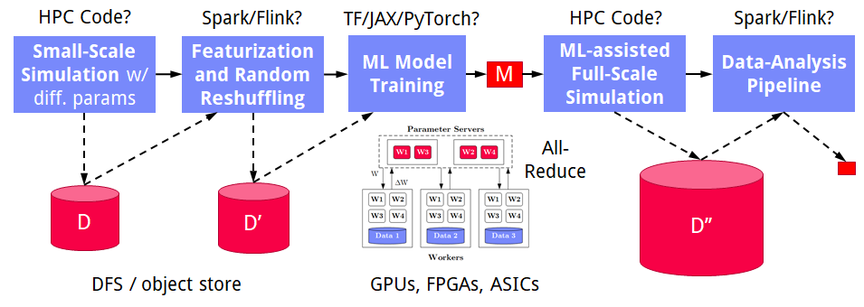
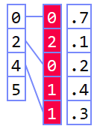
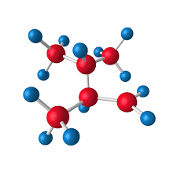
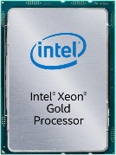
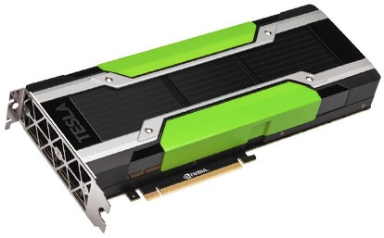
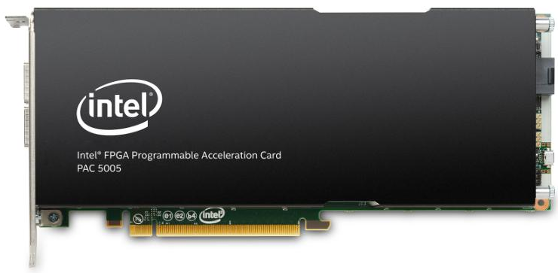
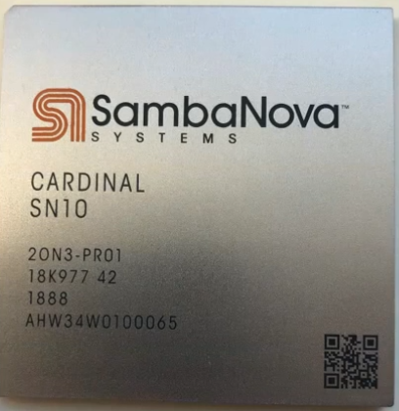
Challenges
Deployment Challenges
Hardware Challenges
DM+ML+HPC share compilation and runtime techniques / converging cluster hardware
End of Dennard scaling
End of Moore’s law
Amdahl’s law
DAPHNE Overall Objective:
Open and extensible system infrastructure
Dev Teams
Programming Models
Different Systems/ Libraries
Cluster Under-utilization
Data/File Exchange
Resource Managers
Increasing specialization
#1 Data Representations
#2 Data Placement
#3 Data (Value) Types
graph
Local vs distributed
FP32, FP64, INT8,
INT32, INT64, UINT8, BF16, TF32, FlexPoint
CPUs/ NUMA
dense
sparse
compressed
GPUs
Sparsity Exploitation from Algorithms to HW
FPGAs/ ASICs
[NVIDIA A100]
4

Slide 5




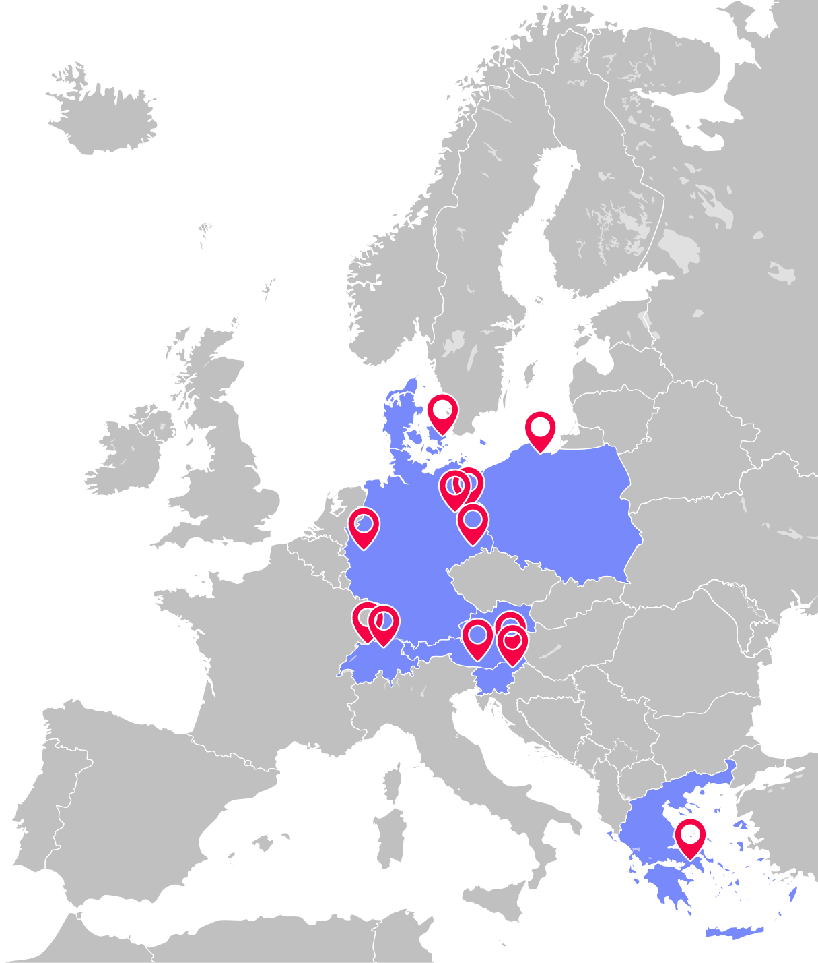






Project Consortium
Know-Center GmbH (coordinator), Austria
14 Partner Institutions from 7 European Countries
Different Backgrounds
Data Management
High-Performance Computing
ML Systems
ML/NLP/Graph Algorithms
Simulation & Optimization
Different Application Domains
Academia and Industry
AVL List GmbH, Austria
Deutsches Zentrum für Luft- und Raumfahrt e.V., Germany
Eidgenössische Technische Hochschule Zürich, Switzerland
Hasso-Plattner-Institut for Digital Engineering gGmbH, Germany
Institute of Communication and Computer Science, Greece
Infineon Technologies Austria AG, Austria
Intel Technology Poland sp. z o.o., Poland
IT-Universitetet i København, Denmark
Kompetenzzentrum Automobil- und Industrieelektronik GmbH, Austria
Technische Universität Berlin, Germany
Technische Universität Dresden, Germany
Univerza v Mariboru, Slovenia
Universität Basel, Switzerland
5

Slide 6




Example Use Cases
[Xiao Xiang Zhu et al: So2Sat LCZ42: A Benchmark Dataset for the Classification of Global Local Climate Zones. GRSM 8(3) 2020]
[So2Sat LC42: https://mediatum.ub.tum.de/1454690]
DLR Earth Observation
ESA Sentinel-1/2 datasets → 4PB/year
Training of local climate zone classifiers on So2Sat LCZ42 (15 experts, 400K instances, 10 labels each, ~55GB HDF5)
ML pipeline: preprocessing, ResNet-20, climate models
IFAT Semiconductor Ion Beam Tuning
KAI Semiconductor Material Degradation
AVL Vehicle Development Process (ejector geometries, KPIs)
ML-assisted simulations, data cleaning, augmentation
Cleaning during exploratory query processing
6

Slide 7
Overview of DAPHNE

Slide 8
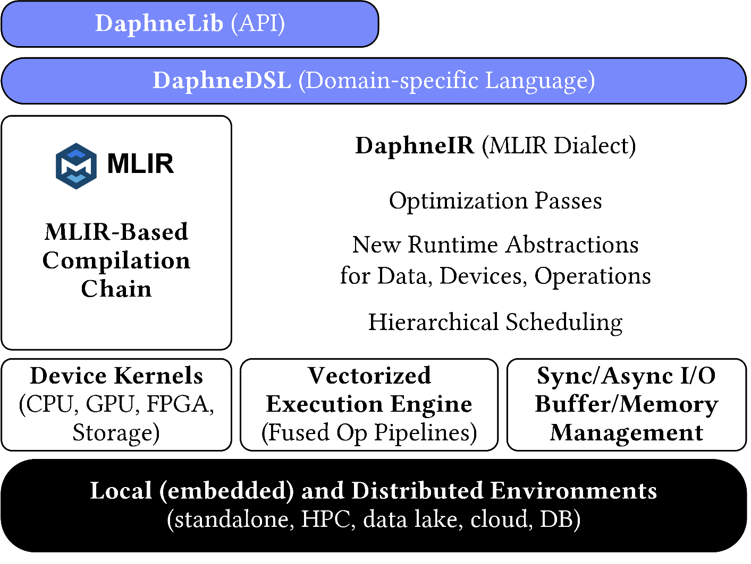
System Architecture
System Architecture
Python API w/ lazy evaluation

Slide 9
Language Abstractions
DSL for linear and relational algebra
System Architecture
Coarse-grained matrix/frame operations
Physical data independence
Built-in operations for linear and relational algebra
High-level operations (e.g., SQL, parameter servers, map)
Conditional control flow (branches, loops)
Typed and untyped user-defined functions
Hierarchy of primitives for data science tasks
Python API w/ lazy evaluation
Example: linear regression model training (simplified)
def lm(X, y) { // X feature matrix, y labels
colmu = means(X, 1); // column means
colsd = stddev(X, 1); // column stddevs
X = (X – colmu) / colsd; // shift and scale
X = cbind(X, 1); // append column of ones
A = t(X) @ X; // t for transpose
b = t(X) @ y; // @ for matrix mult
return solve(A, b); // system of linear eq
}
9

Slide 10
Optimizing Compiler
MLIR-based Optimizing Compiler
System Architecture
Intermediate representation DaphneIR (MLIR dialect)
Systematic lowering from domain-specific operations to calls to pre-compiled kernels for heterogeneous hardware
Traditional programming language rewrites
Type & property inference, inter-procedural analysis
Domain-specific rewrites from linear and relational algebra
Memory management & garbage collection
Device placement & physical operator selection
Python API w/ lazy evaluation
Example: linear regression model training (simplified)
%10:2 = "daphne.vectorizedPipeline"(%5, %colmu, %colsd, %7, %6) ({
^bb0(%arg0: ..., %arg1: ..., %arg2: ..., %arg3: ..., %arg4: ...):
%12 = "daphne.ewSub"(%arg0, %arg1) : ...
%13 = "daphne.ewDiv"(%12, %arg2) : ...
%14 = "daphne.colBind"(%13, %arg3) : ...
%15 = "daphne.gemv"(%14, %arg4) : ... // rewritten from matmul/@
%16 = "daphne.syrk"(%14) : ... // rewritten from matmul/@
"daphne.return"(%15, %16) : ...
}, ...
10

Slide 11
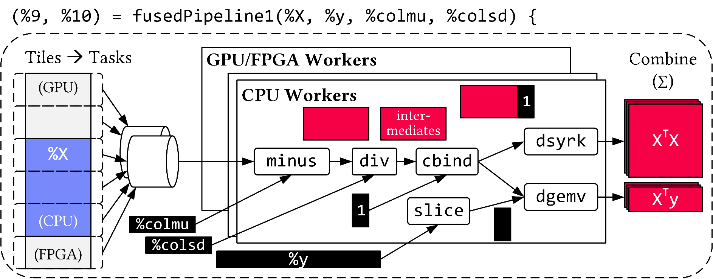
Runtime
Distributed and Local Vectorized Execution
System Architecture
Coarse grained tasks and cache-conscious data binding
Fused operator pipelines on tiles/vectors of data
Device kernels for heterogeneous hardware
Integration of computational storage (e.g., eBPF programs)
Scheduling for load balancing (e.g., for ops on sparse data)
Different distributed backends (e.g., gRPC, OpenMPI)
Python API w/ lazy evaluation
Example: linear regression model training (simplified)
11

Slide 12
Holistic Extensibility

Slide 13
Challenges
Deployment Challenges
Hardware Challenges
DM+ML+HPC share compilation and runtime techniques / converging cluster hardware
End of Dennard scaling
End of Moore’s law
Amdahl’s law
DAPHNE Overall Objective:
Open and extensible system infrastructure
DAPHNE Overall Objective:
Open and extensible system infrastructure
Dev Teams
Programming Models
Different Systems/ Libraries
Cluster Under-utilization
Data/File Exchange
Resource Managers
Increasing specialization
Increasing specialization
#1 Data Representations
#2 Data Placement
#3 Data (Value) Types
graph
Local vs distributed
FP32, FP64, INT8,
INT32, INT64, UINT8, BF16, TF32, FlexPoint
CPUs/ NUMA
dense
sparse
compressed
GPUs
Sparsity Exploitation from Algorithms to HW
FPGAs/ ASICs
[NVIDIA A100]
13

Slide 14
Holistic Extensibility
Every relevant aspect of a system for IDA pipelines should be extensible by the user without a deep understanding of the system
Research challenges
How to balance expressiveness vs. increased system complexity?
How to achieve superb performance underneath abstractions?
3 main aspects
Operators
Data representation
Optimization/scheduling
New logical operations
New physical operators with dedicated code for each target hardware device
Often co-designed with hardware & algorithms/apps
New data types (layouts)
New value types
Optimizer must be able to reason about extensions
New optimizer passes
New runtime schedulers
14

Slide 15
Low Barrier of Entry
Typically, all three aspects need to interact to fully integrate a novel hardware device
But: low barrier of entry required for user adoption
No unnecessary effort
No unnecessary restrictions
Ideally no need to touch target system’s code base
Facilitate exploratory specialization
Examples
Add single physical operator for accelerator, but not entire engine
New data/value type should work with existing physical operators (with acceptable performance), no need for re-implementation
No requirement for deep integration into optimizer (allow usage via hints for initial experiments)
15

Slide 16
Towards Holistic Extensibility in DAPHNE

Slide 17
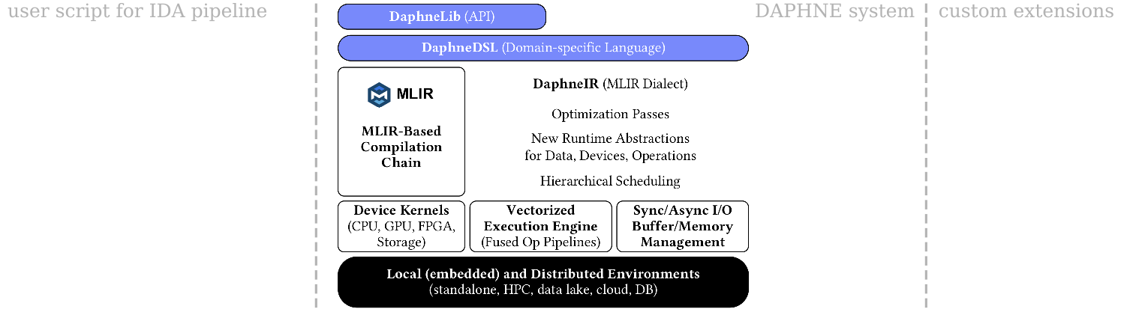
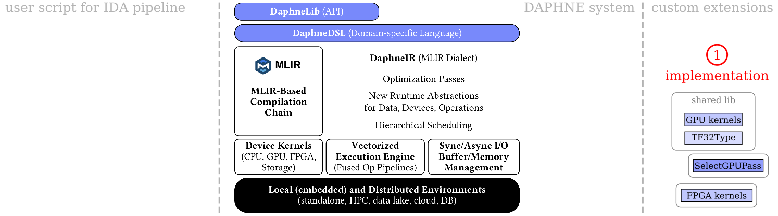
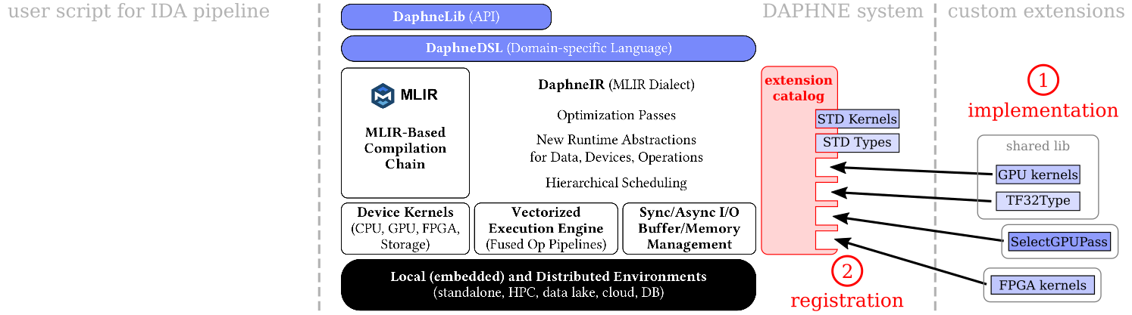
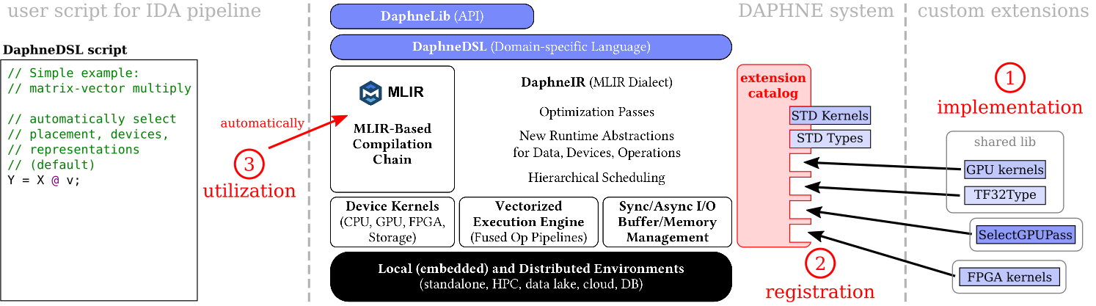
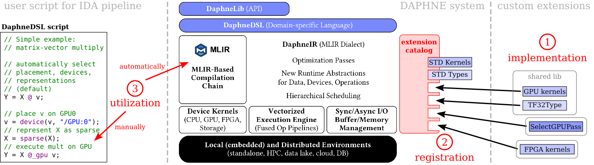
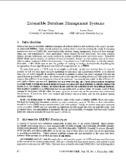
3-Step Approach for Adding/Using Extensions
Abstractions for cost models
Balance of expressiveness and complexity
Interesting properties
Efficiency underneath abstractions
Propagation of hints
Optimize access to extension catalog
Building upon existing works on extensible DBMSs from 1980/90s
Tailored to needs of today’s data processing systems for IDA pipelines
[Michael J. Carey, Laura M. Haas: Extensible Database Management Systems. SIGMOD Rec. 19(4) 1990]
17

Slide 18
Adding a New Physical Operator
void myMatMul(
DenseMatrix<float>& res,
const DenseMatrix<float>* lhs,
const DenseMatrix<float>* rhs
) {
// e.g., cublasSgemm(...), etc.
}
1 Implementation
C++ function, operation-specific interface
Lots of freedom inside the implementation
Offering APIs for common tasks (data transfer, memory management, …)
2 Registration
Provide basic information to make DAPHNE compiler aware of new kernel
Optionally more information (interesting properties/traits, cost models, …)
3 Utilization
Automatically through multiple dispatch based on data/value types
automatically through cost models
Manually in DaphneDSL
C++
myKernels.so
Operation | daphne::MatMulOp
Func name | myMatMul
Shared lib | myKernels.so
Backend | GPU
Input types | [DenseMat<float>, DenseMat<float>]
Output types | [DenseMat<float>]
… | …
extension catalog
// Fully automatic (default)
C = A @ B;
// Choose exact kernel
C = §myMatMul(A, B);
// Choose backend
C = A @_GPU B;
Planned extensions (examples)
Kernels for various hardware backends
Readers/writers for various file formats
Readers/writers for special storage hardware
DaphneDSL
18

Slide 19
Adding a New Data/Value Type
1 Implementation
Interface of DAPHNE matrix or frame (get/set/append values, slice, …)
2 Registration
3 Utilization
Automatically via cost models (e.g., physical size, access patterns, …)
Manually via hints/casts in DaphneDSL
1 Implementation
New C++ type (e.g., struct) with interface for interplay with DAPHNE data types
2 Registration
3 Utilization
Explicitly by the user (application semantics)
Internal selection by the system (e.g., runtime-accuracy trade-off)
Logical type | Frame
Type name | ArrowFrame
Shared lib | myDataTypes.so
… | …
Type name | Quantized8
Size | 8 bit
… | …
XQ = as.matrix<Quantized8>(X);
// Choose data representation
AF = as.ArrowFrame(F);
Planned extensions (examples)
Data types for data layouts of various libraries
Data types for various sparse matrix formats
Value types for quantized, packed, complex, …
Associated operations as ordinary kernels (print/parse, cast, read/write from/to file)
19

Slide 20

Extending the Optimizer or Scheduler
1 Implementation
Leverage extensible nature of MLIR-based optimizing compiler
Implement new MLIR pass
2 Registration
Use MLIR-provided means
Also: integration of 3rd-party dialects from the MLIR ecosystem
3 Utilization
Configure DAPHNE optimizer chain to use new pass at the right stage
1 Implementation
Also follow specific interface
2 Registration
3 Utilization
Manual selection as default scheme
Manual selection for a part of a script
Name | Guided Self-Scheduling (GSS)
Type | dynamic
/bin/daphne --scheduler GSS myScript.daph
[scheduler=“GSS”, nthreads=32] {
// complex calculations
}
Planned extensions (examples)
Passes employing new extensions
Passes deciding placement on accelerators
Extensions for propagation/estimation of interesting data properties
Planned extensions (examples)
Various static/dynamic self-scheduling techniques for local multi-threaded and distributed execution
20

Slide 21
Summary

Slide 22
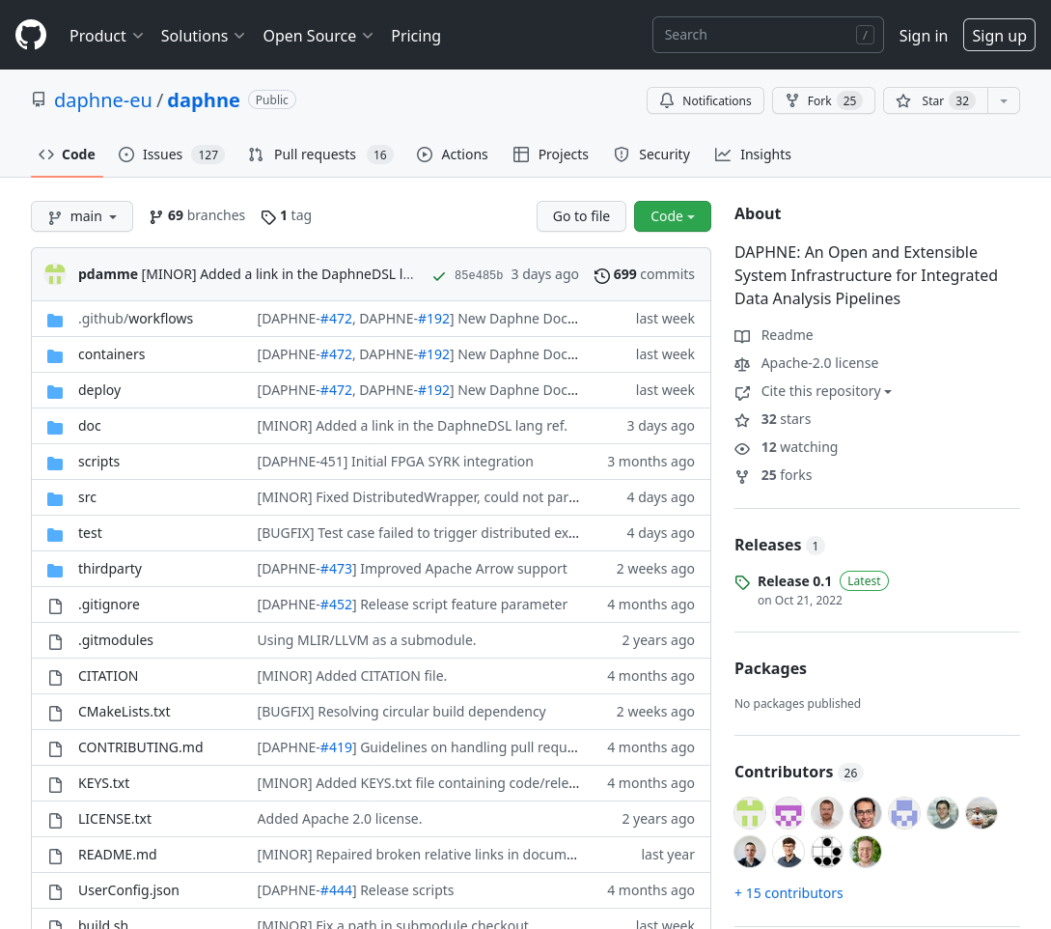

Summary
Holistic Extensibility for Systems tailored to today’s IDA Pipelines
To address increasing specialization
Low barrier of entry for adoption by researchers and users
Current Status
Running DAPHNE prototype
Ongoing work in various components
Extensibility features: WIP
Why should you care?
Simple integration of prototypes (e.g., for novel hardware)
Easy experimentation for researchers
Open for collaborations
Integrated Data Analysis (IDA) Pipelines
DM + ML + HPC
DAPHNE overall objective:
Open and extensible system infrastructure
[Patrick Damme et al.: DAPHNE: An Open and Extensible System Infrastructure for Integrated Data Analysis Pipelines, CIDR 2022]
Open source (Apache v2 license)
https://github.com/daphne-eu/daphne
v0.2 released on July 31, 2023
Towards inclusive developer community
22

Slide 23
Feel free to get in touch: patrick.damme@tu-berlin.de
https://daphne-eu.eu/
https://github.com/daphne-eu
https://twitter.com/daphne_eu
https://www.linkedin.com/in/daphne-eu-project-695735230/

